Slide 1
The First Signs of Knowing: Sign Language to Text
Princess Irabor
Benjamin Sullins

Slide 2
Overview
Problem Description
Methods and Ideas
Experimental Results
Contributions
Future Work

Slide 3
Problem Description

Slide 4







The Problem
Small Population Understands Sign Language.
Becoming Fluent Could Span 2-3 years.
How to Bridge the Gap?
Classes
Learning Progression (2-3 years)
Notes:
Only a few million people understand Sign Language.

Slide 5



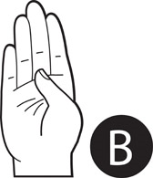
Solution Description
System Capable of Converting Sign Language Images Into Readable Characters
Image Processing
Display

Slide 6
Methods and Ideas

Slide 7
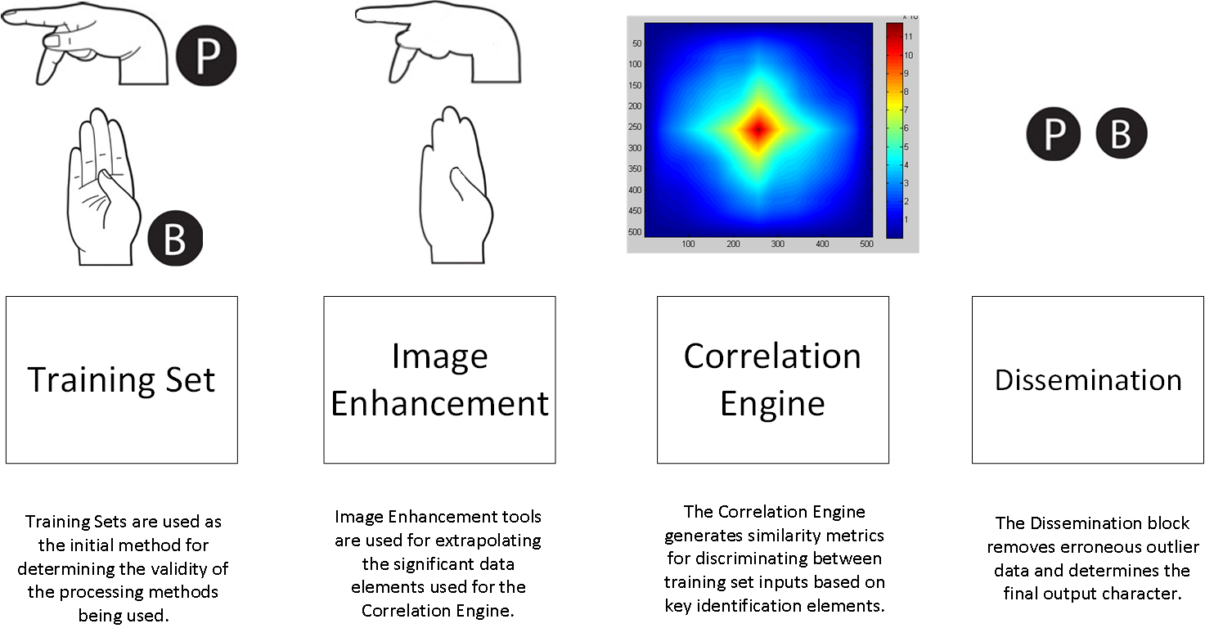
Technical Overview

Slide 8

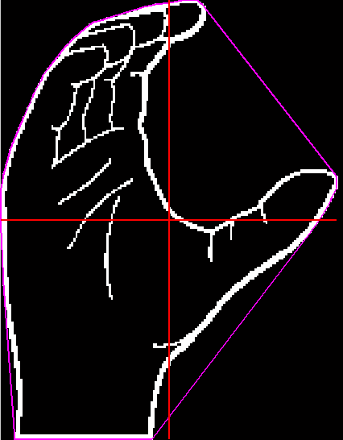
Feature Vectors
Length and Width
Length
Width
Length/Width Extraction

Slide 9
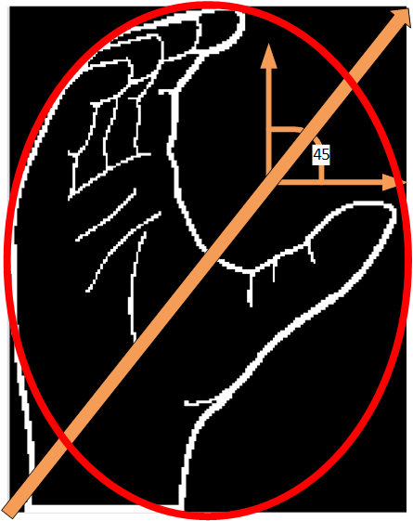
Feature Vectors
Orientation and Eccentricity
Eccentricity
Orientation
Orientation/Eccentricity Extraction

Slide 10
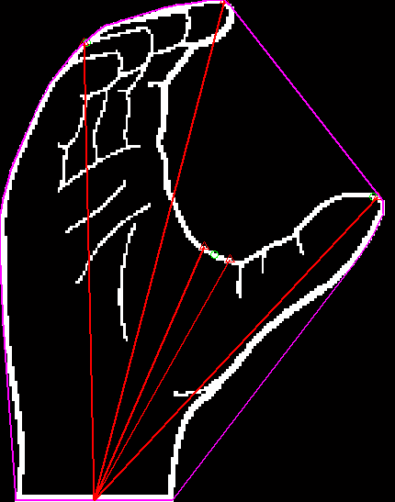
Feature Vectors
Fingertip Segmentation
Fingertip Segmentation
Fingertip Extraction

Slide 11
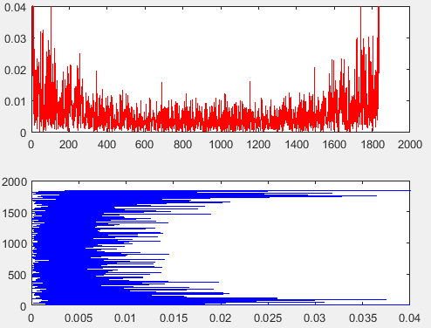
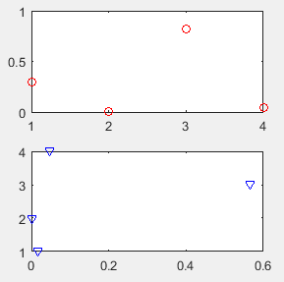
Feature Vectors
Fourier Components
Extraction
Fourier Domain
Feature Vectors
Fourier Component Extraction

Slide 12
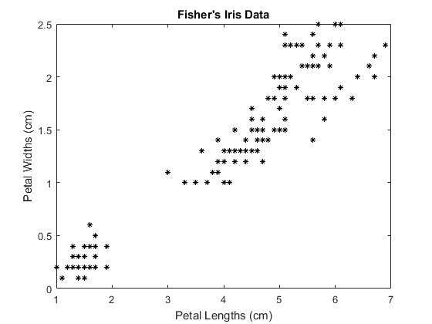
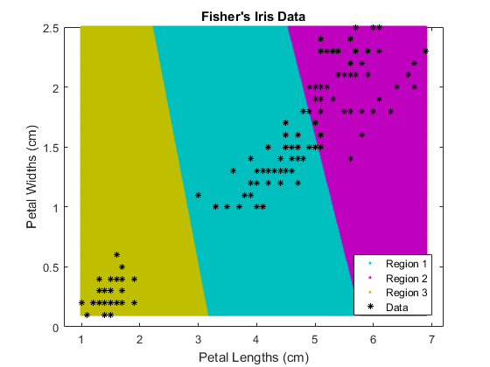
K-Means Clustering
Classify Select Feature Vector Similarities
Reduce Computation
Improve Dissemination
https://www.mathworks.com/help/stats/kmeans.html

Slide 13
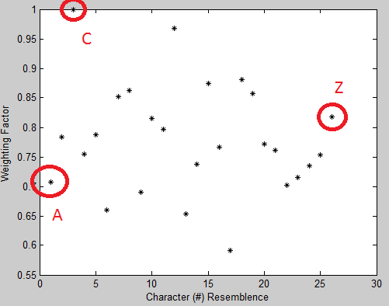

Dissemination
Correlate Feature Vector Clusters to Training Set Expectations
Generates Weighting Table
Feature Vector Cluster Weighting
Highest Weight = Estimated Character

Slide 14
Experimental Results

Slide 15
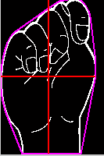
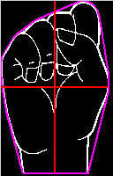
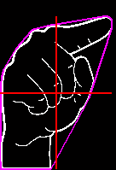
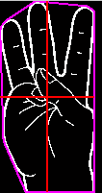
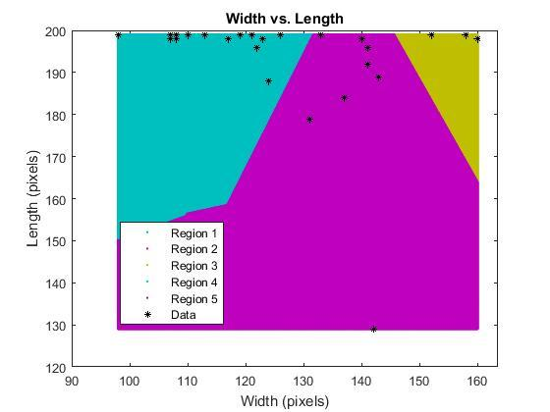
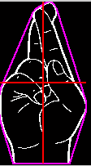
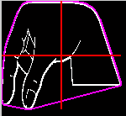
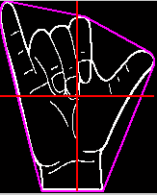
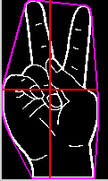
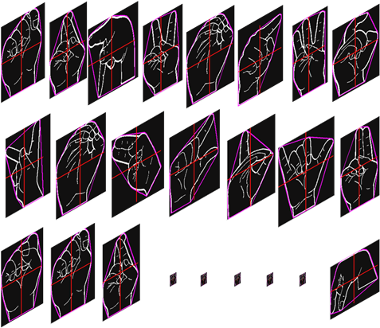
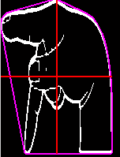
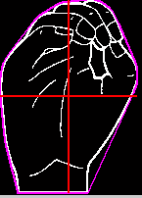
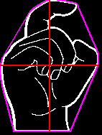
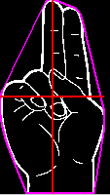
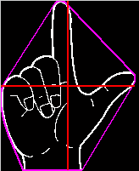
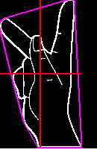
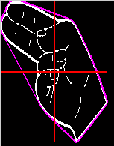

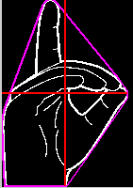
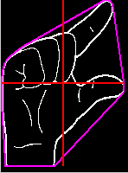
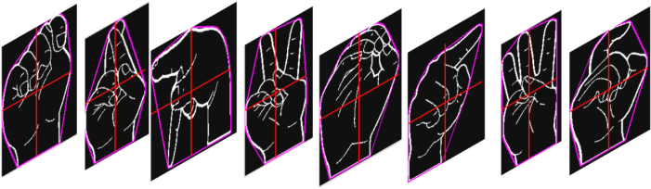
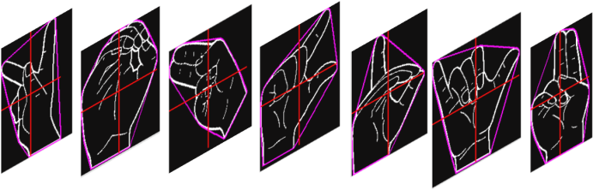
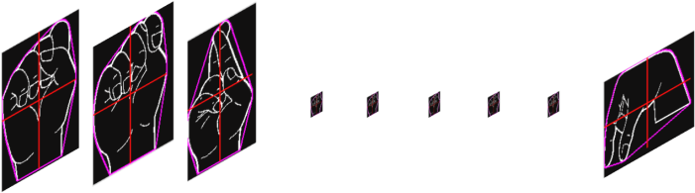
Sign Descriptors
Length
Width/Length Training Feature Vectors
Clustered Through K-Means
Width
Training Set

Slide 16

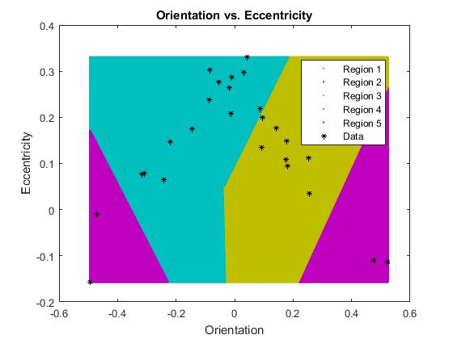
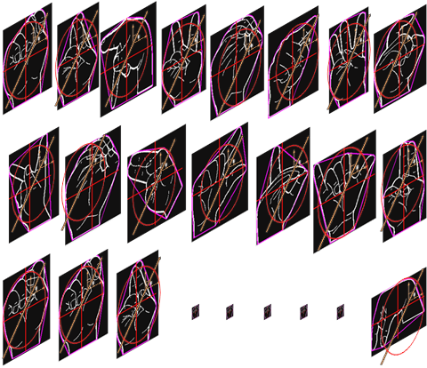
Sign Descriptors
Eccentricity
Orientation/Eccentricity Training Feature
Vectors Clustered Through K-Means
Orientation
Training Set

Slide 17
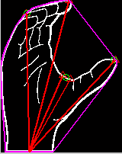
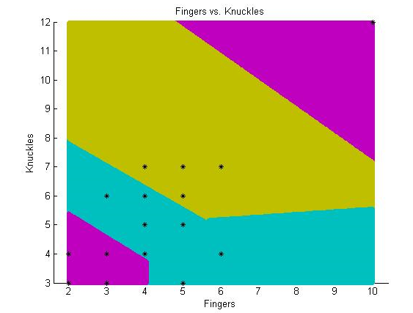
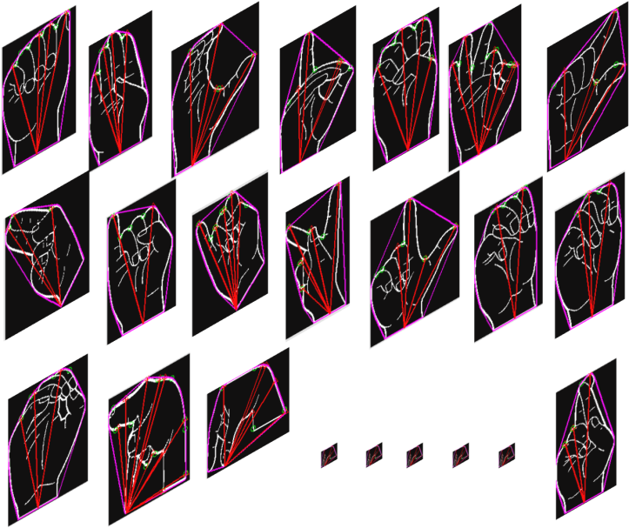
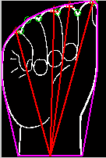
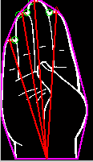
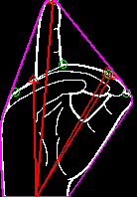
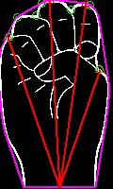
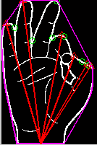
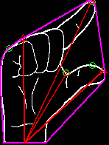
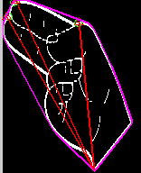
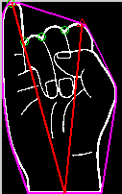
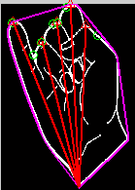
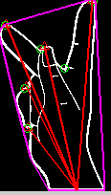
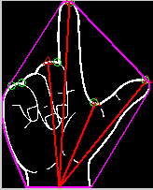
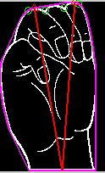
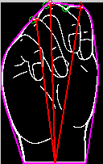





Sign Descriptors
Fingertips
Finger Segmentation Training Features
Clustered Through K-Means
Noisy Element Extractions Encountered
Training Set

Slide 18



Sign Descriptors
Complex Frequency Coefficients
Fourier Descriptor Training Features
Clustered Through K-Means
Notes:
Coefficients : x+jy
Max- complex coefficient of maximum harmonic (xmax+jymax)
Min- minimum complex coefficient (x-min+jy-min)
Zero-frequency – Complex coefficient of the zero frequency harmonic(x-zerofrequency+jyzerofrequency)
First Harmonic – complex coefficient of the first harmonic.(x-firstharmonic+jy-firstharmonic)

Slide 19

Sign Descriptors
Complex Frequency Coefficients
Fourier Descriptor Training Features
Clustered Through K-Means
Notes:
Coefficients : x+jy
Max- complex coefficient of maximum harmonic (xmax+jymax)
Min- minimum complex coefficient (x-min+jy-min)
Zero-frequency – Complex coefficient of the zero frequency harmonic(x-zerofrequency+jyzerofrequency)
First Harmonic – complex coefficient of the first harmonic.(x-firstharmonic+jy-firstharmonic)

Slide 20

Sign Descriptors
Complex Frequency Coefficients
Fourier Descriptor Training Features
Clustered Through K-Means
Notes:
Coefficients : x+jy
Max- complex coefficient of maximum harmonic (xmax+jymax)
Min- minimum complex coefficient (x-min+jy-min)
Zero-frequency – Complex coefficient of the zero frequency harmonic(x-zerofrequency+jyzerofrequency)
First Harmonic – complex coefficient of the first harmonic.(x-firstharmonic+jy-firstharmonic)

Slide 21

Sign Descriptors
Complex Frequency Coefficients
Fourier Descriptor Training Features
Clustered Through K-Means
Notes:
Coefficients : x+jy
Max- complex coefficient of maximum harmonic (xmax+jymax)
Min- minimum complex coefficient (x-min+jy-min)
Zero-frequency – Complex coefficient of the zero frequency harmonic(x-zerofrequency+jyzerofrequency)
First Harmonic – complex coefficient of the first harmonic.(x-firstharmonic+jy-firstharmonic)

Slide 22





Correlation
Capable of Classifying All 26
Alphabet Characters
Weighting Relation to Training Tables

Slide 23
Performance
Need Performance Statistics for Input Signs.
Need Error Rate Statistics for Input Signs.
What Else Do We Need?

Slide 24

Sample Run
Input Training Set
Training Set Feature Extraction
Readme File
Input Sign for Conversion
Resultant Sign After Dissemination
K-Means Clusters
K-Means Clusters
Correlation Weighting Relations
Input Sign Feature Vectors
System Execution Statistics
Project Title
Notes:
Execution:0.9s

Slide 25
Contribution

Slide 26


Contributions
Various Systems Utilize a Single Complex Feature Vector
Our System Integrates Multiple Feature Vectors for Improved Functionality
Before
Single Feature Vector Focus
Computationally Intense
Expansion Limited
Multi Feature Inclusion
After
Handles Similar Characters Effectively
Computationally Simple
Expands Efficiently
Weighting Relation to Training Tables
Notes:
Only a few million people understand Sign Language.

Slide 27
Contributions Cont.
Our System Explores Spatial and Spectral properties of the Sign Image.
Selected Complex Fourier Coefficients represented as Real spectrum Indicators.
Condensed Spectral Representation of Image.
Paired Descriptors are used to generate feature vectors and clusters for classification.

Slide 28
Future Work

Slide 29

Technical Layout Pt.2

Slide 30

Technical Layout Extended Pt.3/4

Slide 31
Conclusion
Princess Irabor
Benjamin Sullins

Slide 32


Sign Descriptors
Complex Frequency Coefficients
Fourier Descriptor Training Features
Clustered Through K-Means
A E J O T Y
Notes:
Coefficients : x+jy
Max- complex coefficient of maximum harmonic (xmax+jymax)
Min- minimum complex coefficient (x-min+jy-min)
Zero-frequency – Complex coefficient of the zero frequency harmonic(x-zerofrequency+jyzerofrequency)
First Harmonic – complex coefficient of the first harmonic.(x-firstharmonic+jy-firstharmonic)

